Slide 1
캡스톤 디자인 2주차
201301489 전영훈
201301511 홍 석
201301512 홍진협

Slide 2
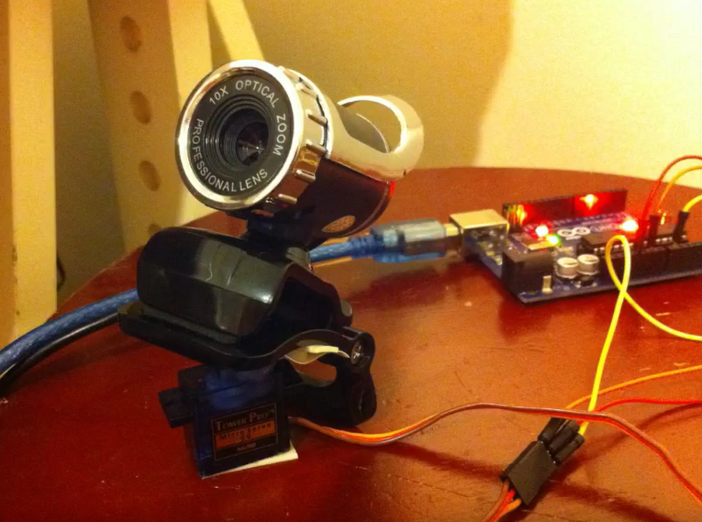
Arduino Powered Automated Security Camera

Slide 3



detect object
image recognize
save information

Slide 4
